Slide 1
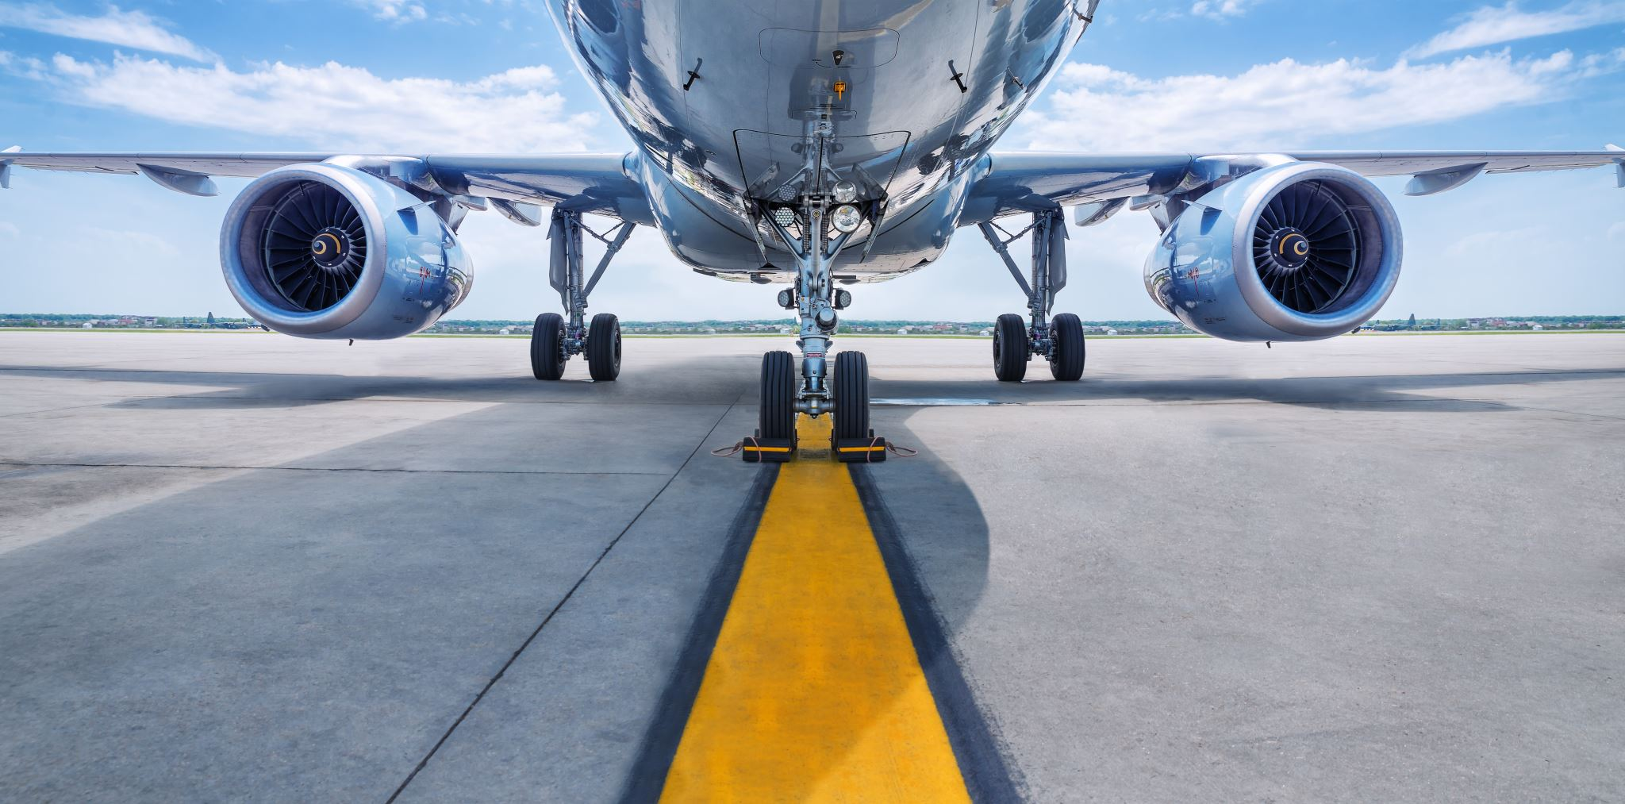
Travel Safety
R.J. Reichhard
Data Analyst

Slide 2
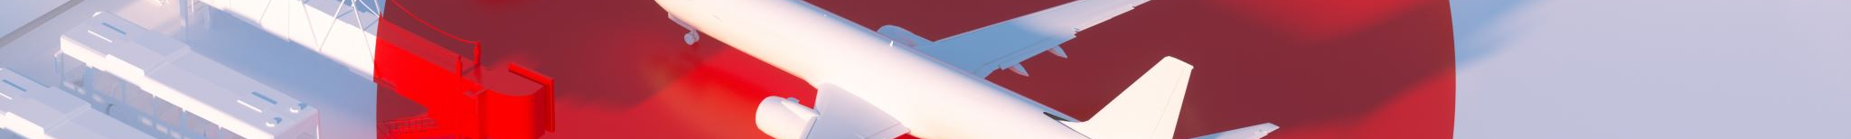
Problem
Media Misinformation
Potential Impacts
Select media outlets have been misleading consumers regarding airline safety
Damage to reputation
Decrease in airline passengers choosing our airline
Loss of shareholder confidence

Slide 3

Data Overview

Slide 4



Main Ideas
Airplane Data
Comparison to Vehicle Travel
Vehicle-only Travel Downsides

Slide 5
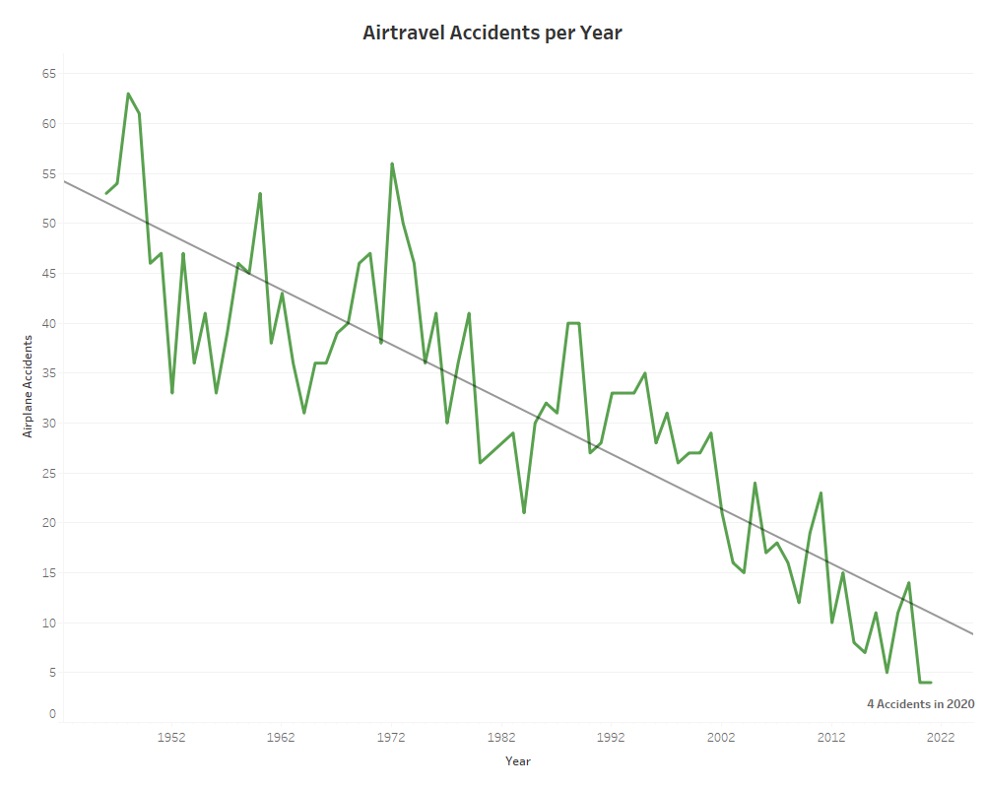
Airplane Accidents Trending

Slide 6
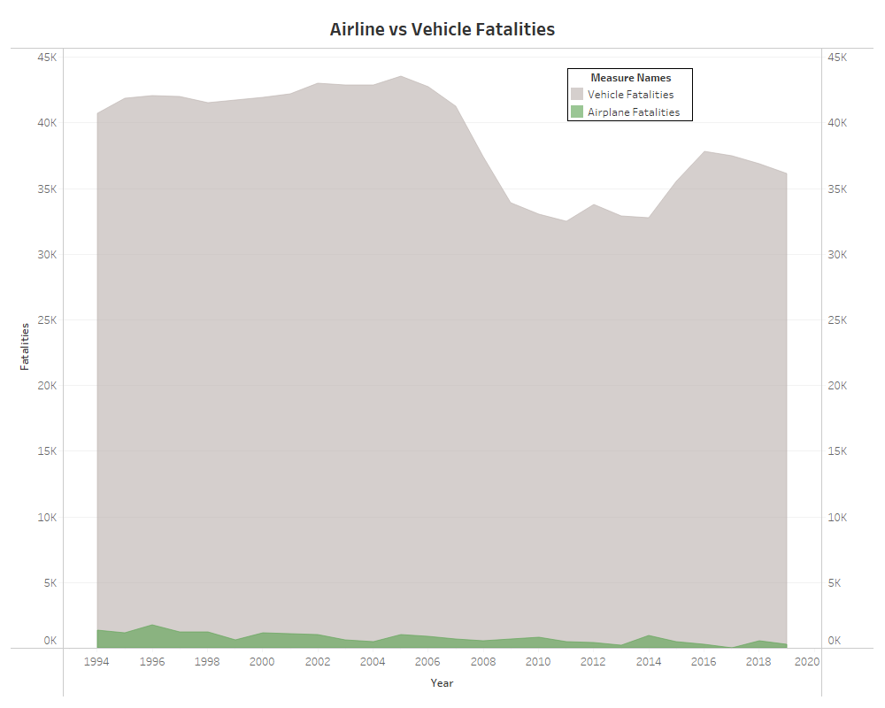
Airline Fatalities Trending
Fatalities

Slide 7
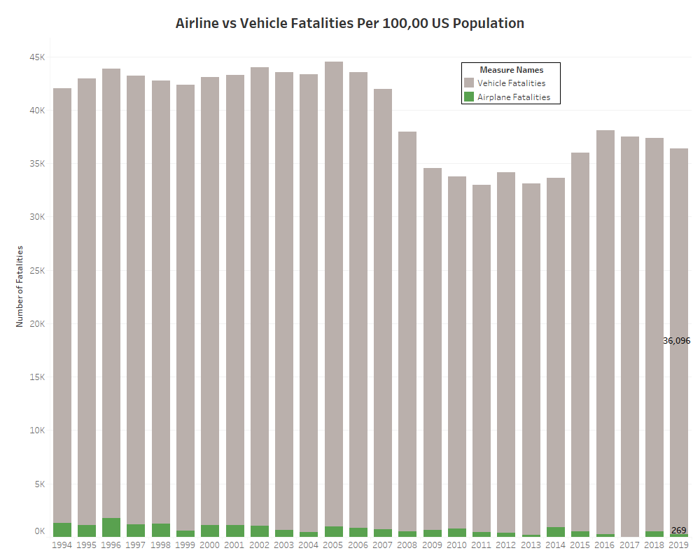

Slide 8
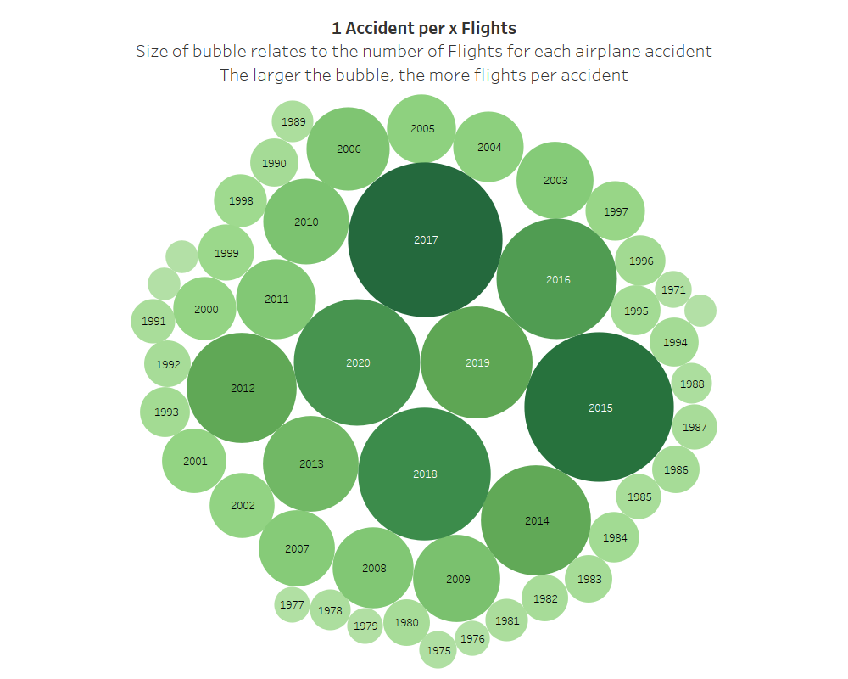
Airplane Accidents : Number of Flights

Slide 9
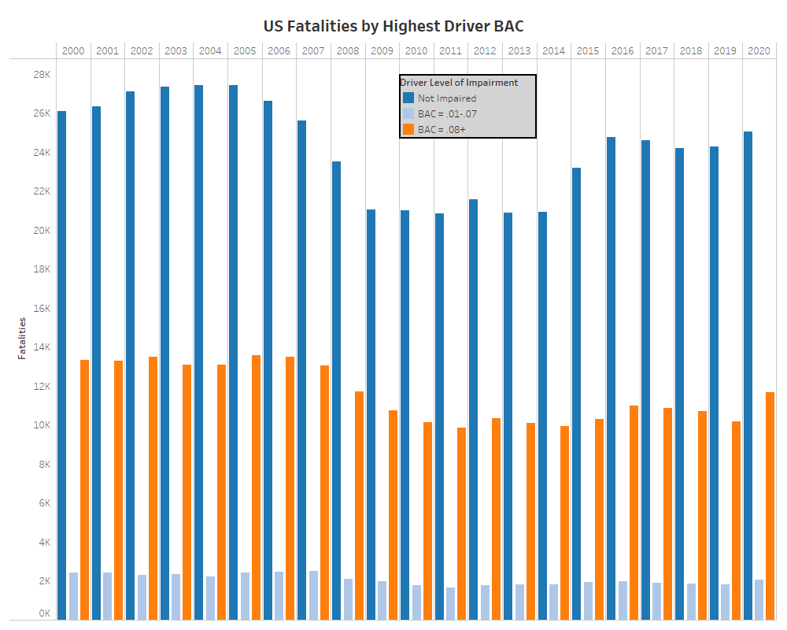
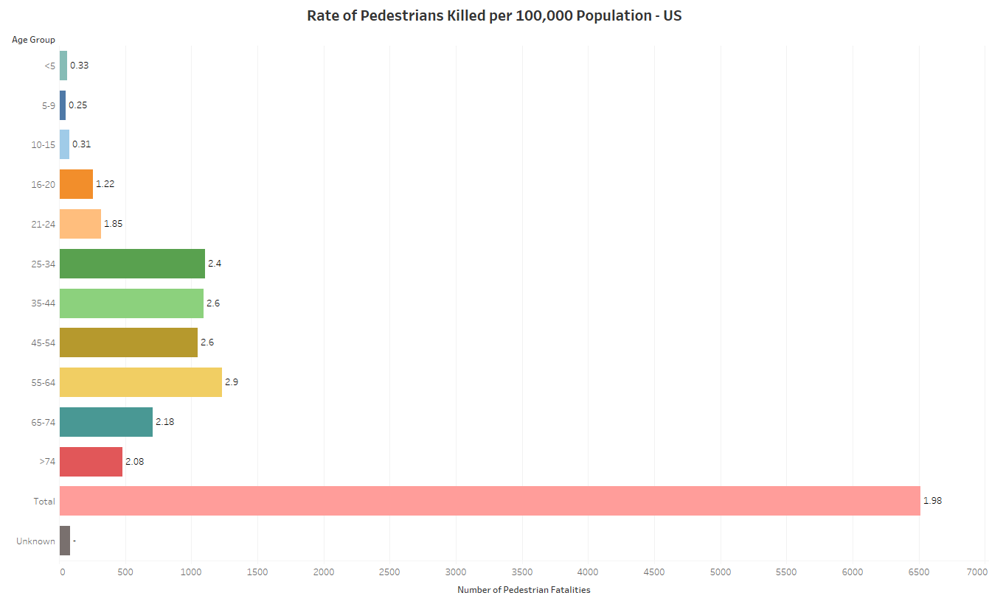
Vehicle Safety Trend
Forecasting for success
Blood Alcohol Content of Vehicle Driver
Pedestrian-involved Accidents in 2020

Slide 10

Solution
Correct the knowledge gap
Communicate correct & sourced data
Target audience
Airline travelers for pleasure
Potential future airline travelers
Shareholders
Two-pronged approach
Shareholder presentation
Strategically publish correct data for target audience

Slide 11

Thank you
R.J. Reichhard
Data Analyst
Robert.Reichhard@gmail.com

Slide 12

Sources
Flight Safety Foundation
https://aviation-safety.net/
National Highway Traffic Safety Administration
https://www-fars.nhtsa.dot.gov/Trends/TrendsGeneral.aspx
FARS 1982-2019 Final, 2020 ARF

